Slide 1

Automate Parking Appeal Process using historical data
Author: Hager Mohamed Magdy

Slide 2
Problem
Time taken by the process of appeals is major problem for many drivers, many drivers are interesting in quick response for their appeals in order to take the right action for their cars if its towed or clamped.
Observing penalty charge notices issued by civil enforcement officers on street and those issued by civil enforcement officers via CCTV can facilitate to solve this problem.

Slide 3
Approach
In this project we are trying to utilize the historical data of penalty charge notices (PNC) to build a system to automate the process of appeals.
Based on this analysis, the driver will be able to receive respond to his appeal early accordingly he could plan for further action. In addition, the city could predict the reason why appeals taken in certain locations are always valid, so could take corrective action and reduce the agent workload.

Slide 4
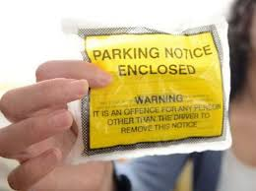
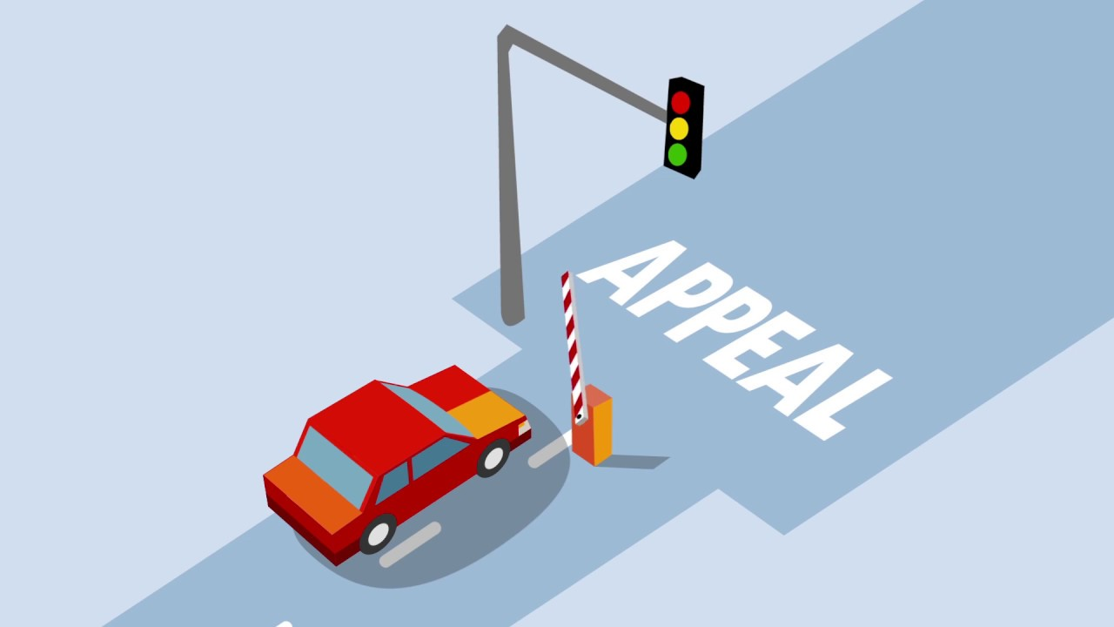


Appeal Parking Process
( Time Consuming ! )

Slide 5
Automated System (OverAll System Structure)
Valid
Appeal
System
Invalid
(Machine Learning Model)
( Time Saved ! )

Slide 6
Modeling Approach
Binary Classification algorithms is used to predict if the appeal is accepted or not
Logistic Regression
KNN
Random forest
DecisionTreeClassifier

Slide 7
Main binary classification metrics were calculated Accuracy, Precision, F1-Score, and Recall
 | Logistic Regression | KNN | Random forest | DecisionTreeClassifier
accuracy | 0.4992080653380528 | 0.7379316043907612 | 0.9750161830126571 | 0.9301720219813516
precision | 0.4992080653380528 | 0.6558415698200645 | 0.9523859575362623 | 0.9589024964672633
recall | 1.0 | 0.99955857198035 | 0.9999448214975446 | 0.8986370909893505
f1 | 0.6659623528979449 | 0.7920164393144457 | 0.9755861215041318 | 0.9277921781980801

Slide 8
Classification Summary
Random Forests scored best .
Random Forest scored better than other classifiers in Recall (Sensitivity) while DecisionTreeClassifier scored better in Precision

Slide 9
Business goals
Maximize profit
Maximize profit [without approve many false appeals]
Reduce response time when appeals’ number is too high

Slide 10
Future work
The model can be integrated in a system utilize by the city /government to automate the processing of the routine appeals.
The model can be translated to mobile application for the drivers.

Slide 11
THANK YOU

